Slide 1
An Overview of Multiple Testing Procedures for Categorical Data
Joe Heyse
IMPACT Conference
November 20, 2014

Slide 2


Slide 3
Abstract
Multiple comparison and multiple endpoint procedures are applied universally in a broad array of experimental settings. In confirmatory clinical trials of candidate drug and vaccine products the interest is in controlling the family-wise error rate (FWER) at a specified level α. Gaining popularity in many other discovery settings is an interest in maintaining the false discovery rate (FDR) as an attractive alternative to strict FWER control. Yosef Hochberg made impactful contributions to both FWER methods (Hochberg, 1988) and FDR methods (Benjamini and Hochberg, 1995) which are widely used in biopharmaceutical applications.
When one or more of the hypotheses being tested is based on categorical data, it is possible to increase the power of FWER and FDR controlling procedures. This talk will trace the development of multiple comparison procedures for categorical data, starting with a proposal by Mantel (1980), and continuing to the development of fully discrete FDR controlling procedures. Special attention will be given to Hochberg’s contributions. The situation with multiple correlated endpoints will also be discussed. Simulations and theoretical arguments demonstrate the clear power advantages of multiplicity procedures that take proper accounting of the discreteness in the data.

Slide 4
Overview
Yosef Hochberg made impactful contributions to both FWER methods and FDR methods which are widely used in biopharmaceutical applications.
With discrete data it is possible to increase the power of FWER and FDR controlling procedures.
This talk will trace the development of multiple comparison procedures for categorical data from early FWER procedures to fully discrete FDR controlling procedures.
Special attention will be given to Hochberg’s contributions.
The situation with multiple correlated endpoints will also be discussed.
Simulations and theoretical arguments demonstrate the clear power advantages of multiplicity procedures that take proper accounting of the discreteness in the data.

Slide 5
Outline
Rodent carcinogenicity study circa 1980
Tests based on P_{min}
Discrete Bonferroni method
Discrete Hochberg stepwise method
Non-independent hypotheses
Discrete FDR methods
Concluding remarks

Slide 6
Summary of Statistical Results From a Long-Term Carcinogenicity Study in Male Mice
Tumor Site | Control 0 | Test Agent Dose |  |  | Trend P-Value
 |  | 2 | 4 | 8
Liver, hepatocellular carcinoma | 1 | 0 | 1 | 3 | 0.0342
PSU, hemangiosarcoma | 0 | 1 | 0 | 1 | 0.20
Adrenal cortex, adenoma | 0 | 0 | 0 | 1 | 0.20
PSU, sarcoma | 0 | 0 | 0 | 1 | 0.20
PSU, lymphoma | 7 | 4 | 1 | 6 | 0.24
Lung, adenoma | 16 | 8 | 6 | 11 | 0.24
Liver, hepatocellular adenoma | 12 | 6 | 7 | 6 | 0.49
Liver, hemangiosarcoma | 2 | 0 | 0 | 1 | 0.50
Harderian gland, adenoma | 2 | 0 | 0 | 1 | 0.50
Skin, fibroma | 1 | 0 | 1 | 0 | 0.50
Thyroid, follicular cell carcinoma | 1 | 0 | 1 | 0 | 0.50
PSU, leukemia | 5 | 2 | 2 | 2 | 0.44N
Lung, adenocarcinoma | 0 | 3 | 0 | 0 | 0.41N
Testes, interstitial cell tumor | 1 | 1 | 1 | 0 | 0.41N
Stomach, papilloma | 2 | 0 | 0 | 0 | 0.16N
Number of mice on study | 100 | 50 | 50 | 50

Slide 7
Multiplicity of Statistical Tests
Liver, hepatocellular carcinoma was only 1 of K=15 tumor sites encountered.
P₍₁₎=0.0342 was the most extreme individual trend P-value.
Interest is in the likelihood of observing P₍₁₎=0.0342 as the most extreme P-value among the K=15 in this study.
Need to consider the discrete nature of the data since several tumor sites may not be able to achieve significance levels of P₍₁₎.

Slide 8
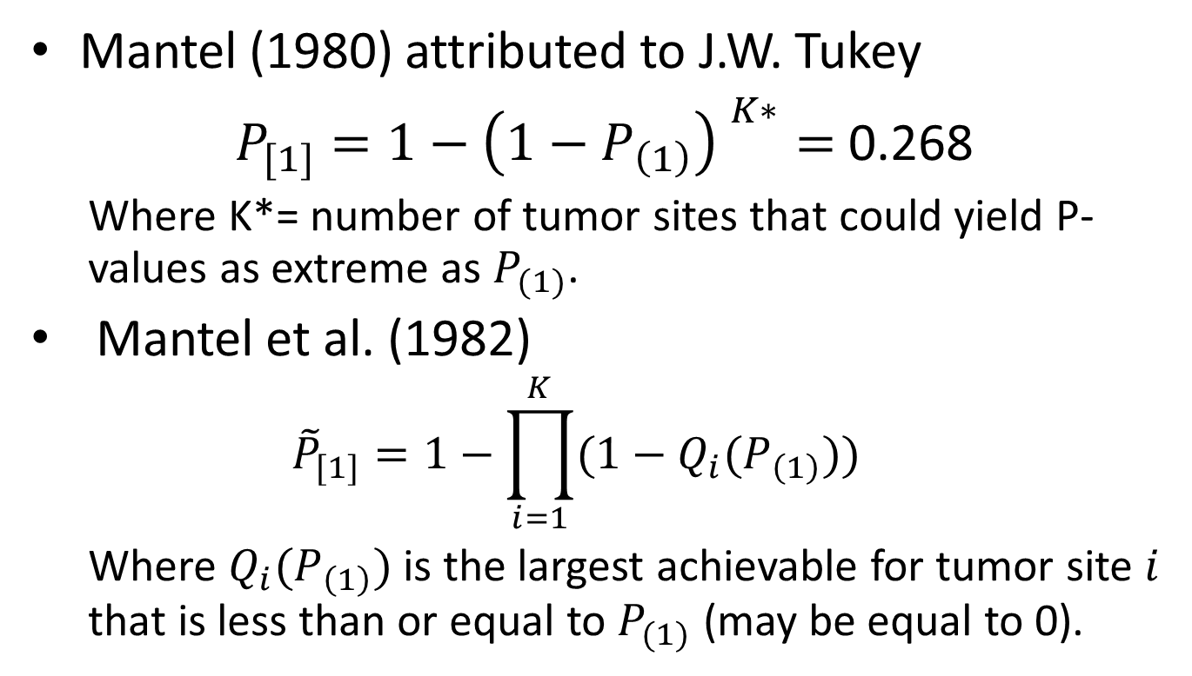
P-value Adjustment Methods
Mantel (1980) attributed to J.W. Tukey
$P_{[1]}=1−{\left(1−P_{\left(1\right)}\right) }^{K∗}=$ 0.268
  Where K*= number of tumor sites that could yield P-values as extreme as $P_{(1)}$.
Mantel et al. (1982)
  $${\tilde{P}}_{[1]}=1−\prod_{i=1}^{K}{(1−Q_{i}(P_{\left(1\right)})})$$
  Where $Q_{i}(P_{\left(1\right)})$ is the largest achievable for tumor site $i$ that is less than or equal to $P_{(1)}$ (may be equal to 0).

Slide 9
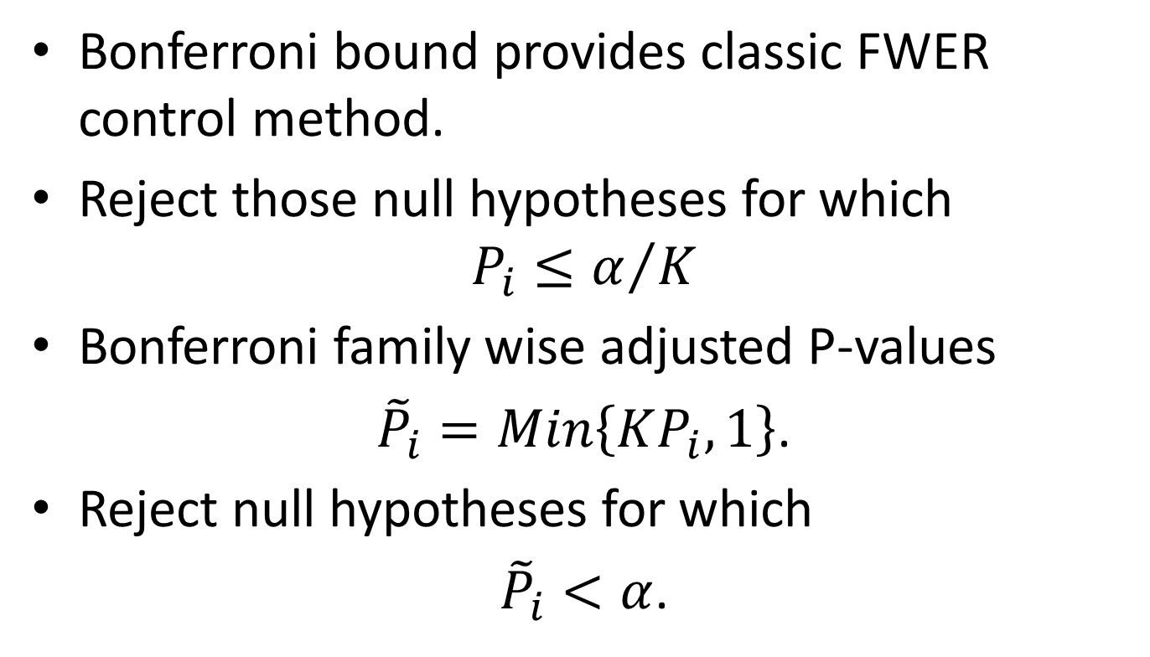
Bonferroni Bound
Bonferroni bound provides classic FWER control method.
Reject those null hypotheses for which
$$P_{i}≤α/K$$
Bonferroni family wise adjusted P-values
${\tilde{P}}_{i}=Min\left\{KP_{i}, 1\right\}$.
Reject null hypotheses for which
${\tilde{P}}_{i}<α$.

Slide 10
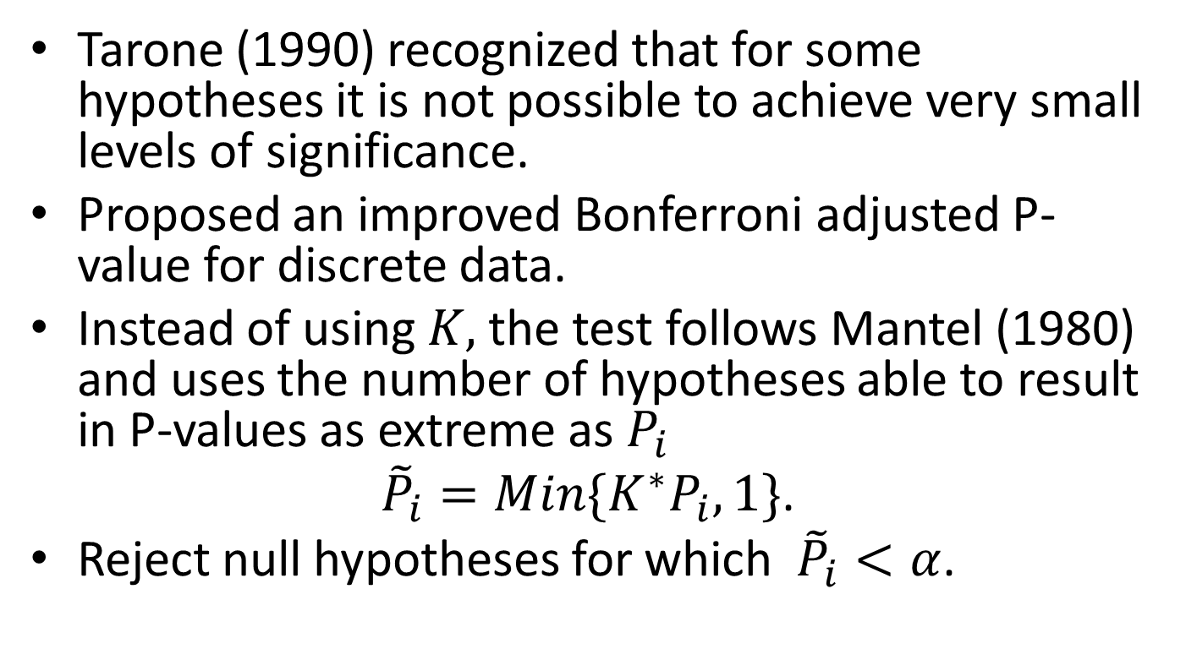
Discrete Adjusted Bonferroni
Tarone (1990) recognized that for some hypotheses it is not possible to achieve very small levels of significance.
Proposed an improved Bonferroni adjusted P-value for discrete data.
Instead of using $K,$ the test follows Mantel (1980) and uses the number of hypotheses able to result in P-values as extreme as $P_{i}$
${\tilde{P}}_{i}=Min\{K^{∗}P_{i}, 1\}$.
Reject null hypotheses for which ${\tilde{P}}_{i}<α$.

Slide 11
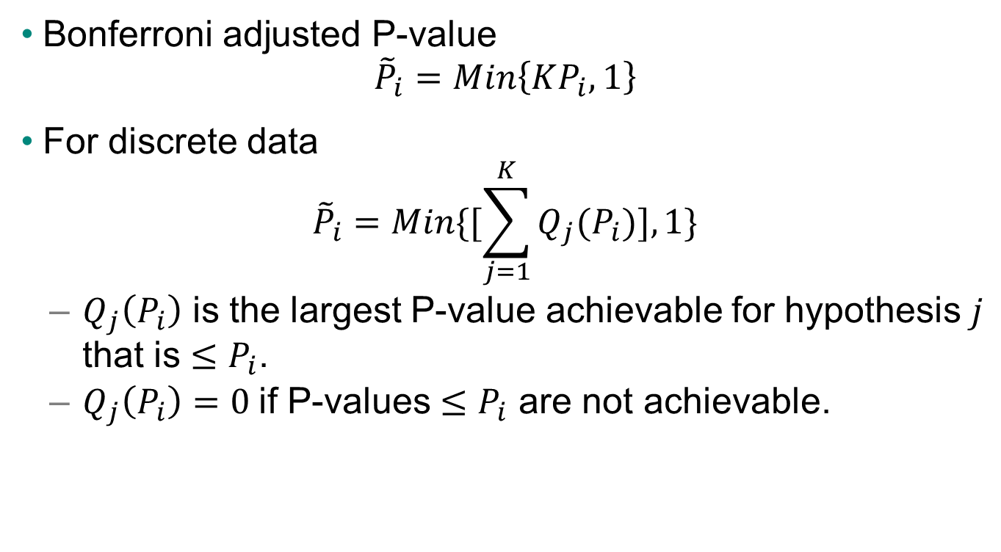
Modified Bonferroni for Discrete Data
Bonferroni adjusted P-value
$${\tilde{P}}_{i}=Min\left\{KP_{i}, 1\right\}$$
For discrete data
$${\tilde{P}}_{i}=Min\{[\sum_{j=1}^{K}{Q_{j}(P_{i})], 1\}}$$
  $Q_{j}\left(P_{i}\right)$ is the largest P-value achievable for hypothesis $j$ that is $≤P_{i}$.
  $Q_{j}\left(P_{i}\right)=0$if P-values $≤P_{i}$ are not achievable.

Slide 12
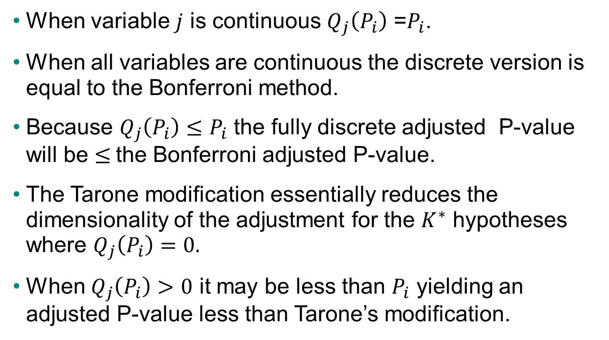
Notes for Discrete Bonferroni
When variable $j$ is continuous $Q_{j}\left(P_{i}\right)$ =$P_{i}$.
When all variables are continuous the discrete version is equal to the Bonferroni method.
Because $Q_{j}\left(P_{i}\right)≤P_{i}$ the fully discrete adjusted P-value will be $≤$the Bonferroni adjusted P-value.
The Tarone modification essentially reduces the dimensionality of the adjustment for the $K^{∗}$ hypotheses where $Q_{j}\left(P_{i}\right)=0.$
When $Q_{j}\left(P_{i}\right)>0$ it may be less than $P_{i}$ yielding an adjusted P-value less than Tarone’s modification.

Slide 13
Bonferroni: Probability of Falsely Rejecting 1 or More True Hypotheses for Increasing Numbers Hypotheses
Number of Hypotheses
Number of Hypotheses

Slide 14
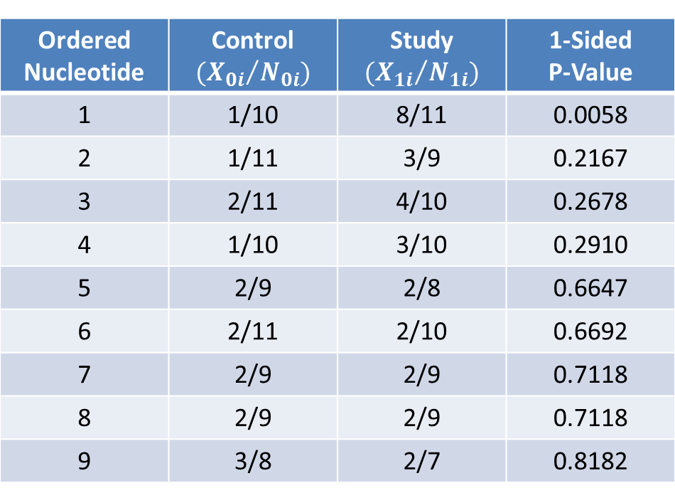
Nucleotide Changes in cDNA Transcripts (Tarone, 1990)
Ordered Nucleotide | Control $${{(X}_{0i}}/{N_{0i}})$$ | Study $${{(X}_{1i}}/{N_{1i}})$$ | 1-Sided P-Value
1 | 1/10 | 8/11 | 0.0058
2 | 1/11 | 3/9 | 0.2167
3 | 2/11 | 4/10 | 0.2678
4 | 1/10 | 3/10 | 0.2910
5 | 2/9 | 2/8 | 0.6647
6 | 2/11 | 2/10 | 0.6692
7 | 2/9 | 2/9 | 0.7118
8 | 2/9 | 2/9 | 0.7118
9 | 3/8 | 2/7 | 0.8182

Slide 15
Multiplicity Adjustment for cDNA data
Unadjusted P-value for Nucleotide 1: P = 0.0058
Bonferroni: P-adj = 0.0522
(= 9 x 0.0058)
Tarone Adjusted Bonferroni: P-adj = 0.0116
(= 2 x 0.0058)
Discrete Bonferroni: P-adj = 0.0097
(= 0.0058 + 0.0039)

Slide 16
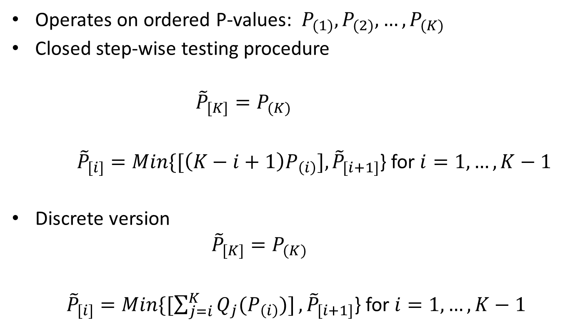
Hochberg (1988) Step-up Procedure
Operates on ordered P-values: $P_{(1)}, P_{(2)}, …, P_{(K)}$
Closed step-wise testing procedure
      $${\tilde{P}}_{[K]}=P_{(K)}$$
    ${\tilde{P}}_{[i]}=Min\{[\left(K−i+1\right)P_{\left(i\right)}], {\tilde{P}}_{[i+1]}$} for $i=1, …, K−1$
Discrete version
    $${\tilde{P}}_{[K]}=P_{(K)}$$
    ${\tilde{P}}_{[i]}=Min\{[\sum_{j=i}^{K}{Q_{j}(P_{\left(i\right)})]}, {\tilde{P}}_{[i+1]}$} for $i=1, …, K−1$

Slide 17
Hochberg: Probability of Falsely Rejecting 1 or More True Hypotheses for Increasing Numbers Hypotheses
Number of Hypotheses
Number of Hypotheses

Slide 18
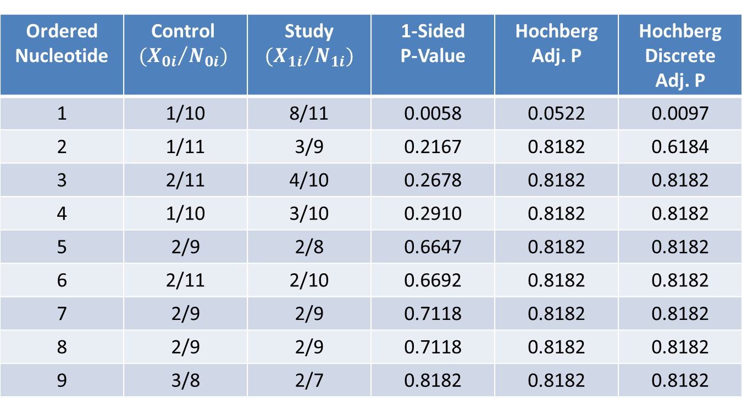
Nucleotide Changes in cDNA Transcripts (Tarone, 1990)
Ordered Nucleotide | Control $${{(X}_{0i}}/{N_{0i}})$$ | Study $${{(X}_{1i}}/{N_{1i}})$$ | 1-Sided P-Value | Hochberg Adj. P | Hochberg Discrete Adj. P
1 | 1/10 | 8/11 | 0.0058 | 0.0522 | 0.0097
2 | 1/11 | 3/9 | 0.2167 | 0.8182 | 0.6184
3 | 2/11 | 4/10 | 0.2678 | 0.8182 | 0.8182
4 | 1/10 | 3/10 | 0.2910 | 0.8182 | 0.8182
5 | 2/9 | 2/8 | 0.6647 | 0.8182 | 0.8182
6 | 2/11 | 2/10 | 0.6692 | 0.8182 | 0.8182
7 | 2/9 | 2/9 | 0.7118 | 0.8182 | 0.8182
8 | 2/9 | 2/9 | 0.7118 | 0.8182 | 0.8182
9 | 3/8 | 2/7 | 0.8182 | 0.8182 | 0.8182

Slide 19
Non-independent Hypotheses
Accounting for a known structure can improve the power of the testing procedure.
Heyse and Rom (1988) proposed a multivariate permutation test for the rodent carcinogenicity experiment.
Westfall and Young (1989, 1993) developed broader resampling approaches which have become the standard application (PROC MULTTEST).
Possible to construct exact null distribution for discrete test statistics.

Slide 20
Illustration: Multiresponse representation of tumor data
 | Control (X=0) | Treated (X=1) | Total
Tumor Site A Only | 1 | 6 | 7
Tumor Site B Only | 3 | 0 | 3
Tumor Sites A&B | 1 | 2 | 3
No Tumor | 45 | 42 | 87
Number on Study | 50 | 50 | 100
Site A: S_{A} = 8, E(S_{A}) = 5
Site B: S_{B} = 2, E(S_{B}) = 3

Slide 21
Bivariate distribution of scores

Slide 22
Rejection regions based on bivariate distribution of scores
Modified Bonferroni
S_{A}=6 | S_{A}=7 | S_{A}=8 | S_{A}=9 | S_{A}=10
--- | --- | --- | --- | A | S_{B}=3
--- | --- | --- | --- | A | S_{B}=4
--- | --- | --- | --- | A | S_{B}=5
B | B | B | AB | AB | S_{B}=6
Hochberg
S_{A}=6 | S_{A}=7 | S_{A}=8 | S_{A}=9 | S_{A}=10
--- | --- | --- | --- | A | S_{B}=3
--- | --- | --- | --- | A | S_{B}=4
--- | --- | --- | --- | A | S_{B}=5
B | B | AB | AB | AB | S_{B}=6

Slide 23

Return to Rodent Carcinogenicity Study
Most-extreme P-value = 0.0342 (Liver, Hepatocellular Carcinoma)
Base Method: $P_{[1]}=1−{(1−P_{\left(1\right)})}^{K}$
Method | Adjusted P-value
Adjust Extreme K=15 | 0.4067
Mantel (K*=9) | 0.2689
Mantel et al. (Discrete) | 0.2352
Heyse and Rom (Permutation) | 0.2363

Slide 24
False Discovery Rate (FDR)
Almost all multiplicity considerations in clinical trial applications are designed to control the Family Wise Error Rate (FWER).
Benjamini and Hochberg (1995) argued that in certain settings, requiring control of the FWER is often too conservative.
They suggested controlling the “False Discovery Rate” (FDR) as a more powerful alternative.
Accounting for the categorical endpoints can further improve the power of FDR (and FWER) methods.

Slide 25
Benjamini & Hochberg FDR
Controlling Procedure
Order the K observed P-values, $P_{(1)}, P_{(2)}, …, P_{\left(K\right)},$with associated hypotheses $H_{(1)}, H_{\left(2\right)}, …, H_{\left(K\right)}.$
Define
Procedure rejects the J hypotheses $H_{(1)}, H_{\left(2\right)}, …, H_{\left(J\right)}.$
If $J=0$then no hypotheses are rejected, and if $J=K$then all hypotheses are rejected.

Slide 26
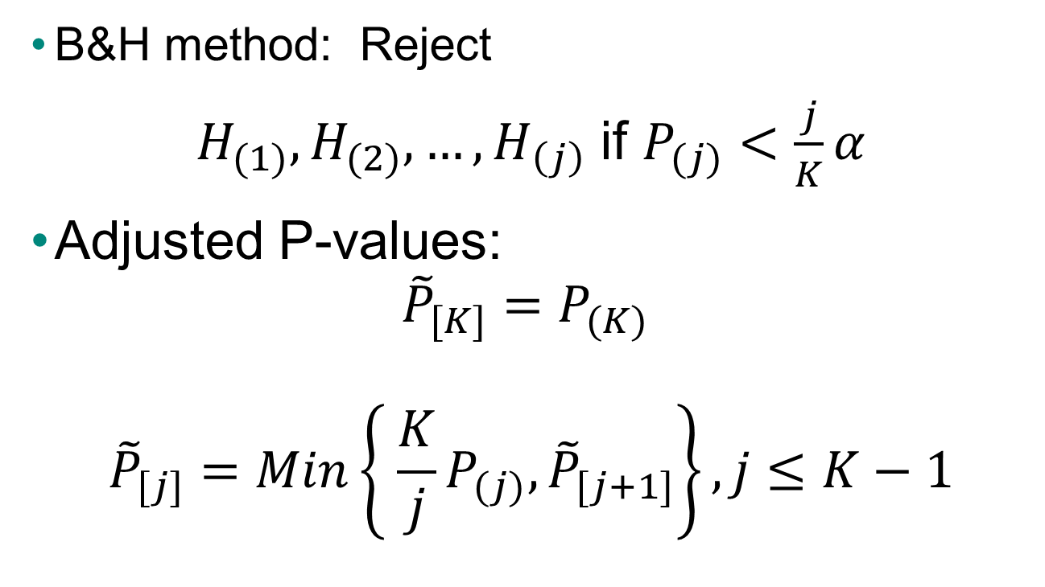
Alternate Formulation of B&H Method
Using Adjusted P-values
B&H method: Reject
$H_{(1)}, H_{(2)}, …, H_{\left(j\right)}$ if $P_{(j)}<\frac{j}{K}α$
Adjusted P-values:
$${\tilde{P}}_{[K]}=P_{(K)}$$
$${\tilde{P}}_{[j]}=Min\left\{ \frac{K}{j}P_{(j)}, {\tilde{P}}_{[j+1]}\right\}, j≤K−1$$

Slide 27
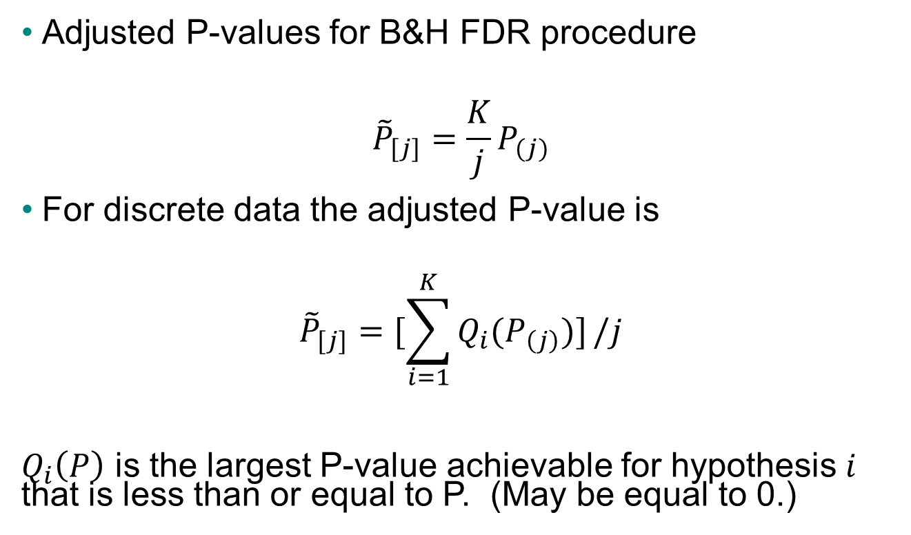
Modified FDR for Discrete Data
Adjusted P-values for B&H FDR procedure
$${\tilde{P}}_{[j]}=\frac{K}{j}P_{(j)}$$
For discrete data the adjusted P-value is
$${\tilde{P}}_{[j]}=[\sum_{i=1}^{K}{Q_{i}(P_{\left(j\right)})]}/j$$
  $Q_{i}\left(P\right)$ is the largest P-value achievable for hypothesis $i$ that is less than or equal to P. (May be equal to 0.)

Slide 28
Properties of FDR Control
The B&H sequential procedure controls the FDR at
FDR < FWER and equality holds if K=K₀.
The Hochberg (1988) stepwise procedure compares
while the FDR procedure compares
FDR is potentially more powerful than FWER controlling procedures.
for independent hypotheses.

Slide 29
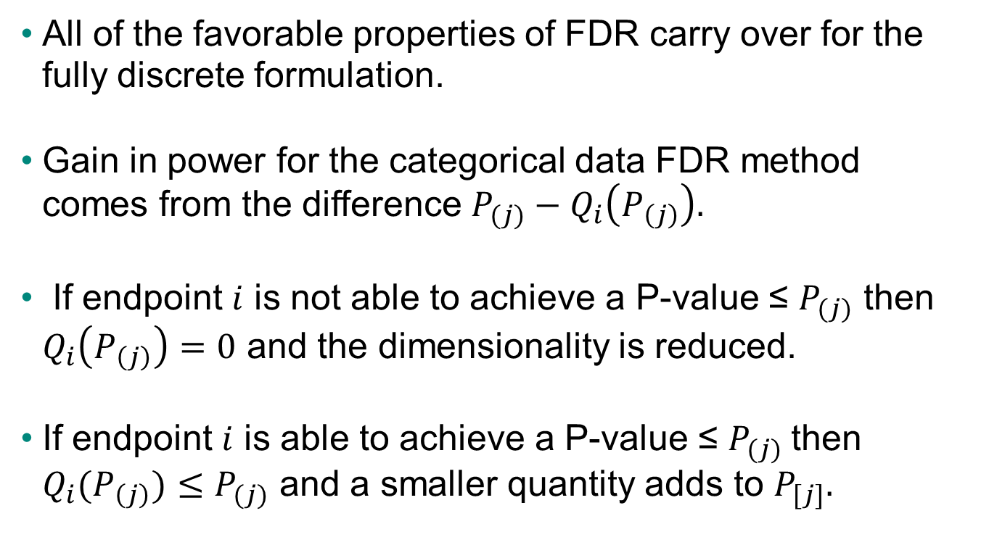
FDR for Categorical Data
All of the favorable properties of FDR carry over for the fully discrete formulation.
Gain in power for the categorical data FDR method comes from the difference $P_{(j)}−Q_{i}\left(P_{\left(j\right)}\right).$
If endpoint $i$ is not able to achieve a P-value ≤ $P_{(j)}$ then $Q_{i}\left(P_{\left(j\right)}\right)=0$ and the dimensionality is reduced.
If endpoint $i$ is able to achieve a P-value ≤ $P_{(j)}$then $Q_{i}(P_{\left(j\right)})≤P_{(j)}$ and a smaller quantity adds to $P_{[j]}.$

Slide 30
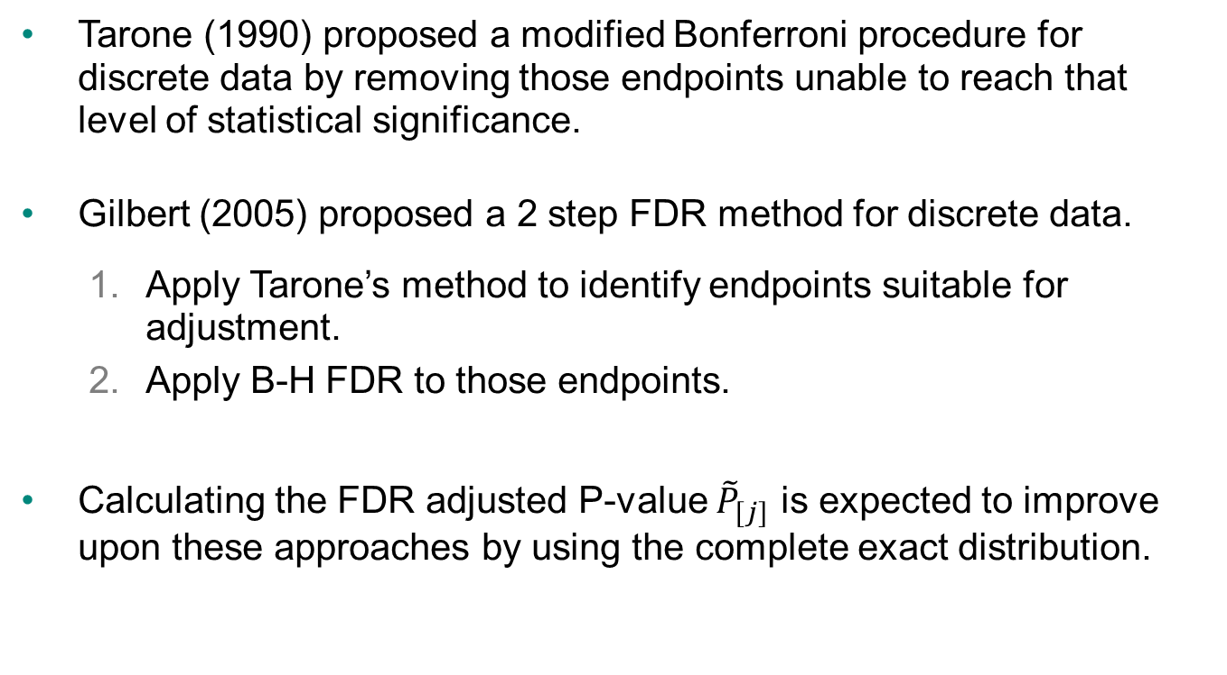
Other Approaches for Categorical Data
Tarone (1990) proposed a modified Bonferroni procedure for discrete data by removing those endpoints unable to reach that level of statistical significance.
Gilbert (2005) proposed a 2 step FDR method for discrete data.
  Apply Tarone’s method to identify endpoints suitable for adjustment.
  Apply B-H FDR to those endpoints.
Calculating the FDR adjusted P-value ${\tilde{P}}_{[j]}$ is expected to improve upon these approaches by using the complete exact distribution.

Slide 31
Example: Genetic Variants of HIV
Gilbert (2005) compared the mutation rates at 118 positions in HIV amino-acid sequences of 73 patients with subtype C to 73 patients with subtype B.
The B-H FDR procedure identified 12 significant positions.
The Tarone modified FDR procedure reduced the dimensionality to 25 and identified 15 significant positions.
The fully discrete FDR identified 20 significant positions.

Slide 32
Recent Developments
Using mid P-values
Heller and Gur (2012) proposed using the B&H method on the mid P-values to reduce the conservatism with discrete data.
Also developed a novel step-down procedure for discrete data.
Simulations showed that the fully discrete adjustment method controlled the FDR and was most powerful among the tests considered.
Example: the 27 most extreme signals from post marketing surveillance of spontaneous adverse experiences was evaluated.
  B&H supported 22 signals
  B&H applied to mid P supported 25 signals
  Fully discrete B&H supported all 27 signals

Slide 33
Simulation Study for Independent Hypotheses
A simulation study was conducted to evaluate the statistical properties of the FDR controlling methods for discrete data using Fisher’s Exact Test.
Simulation parameters
  Number of Hypotheses: K = 5, 10, 15, 20
  Varying numbers of false hypotheses (K-K₀)
  Background rates chosen randomly from U(.01, .5)
  Odds Ratios for Effect Size: OR = 1.5, 2, 2.5, 3
  Sample sizes: N = 10, 25, 50, 100
  α = 0.05 1-Tailed

Slide 34
Rate of Rejecting True Hypotheses
When All Hypotheses Are True (K₀=K)

Slide 35
Rate of Rejecting True Hypotheses
When Some Hypotheses Are False (K₀<K)

Slide 36
Rate of Rejecting False Hypotheses

Slide 37
Concluding Remarks
Understanding and evaluating multiplicity has been a critically important element in biopharmaceutical statistical applications.
Multiplicity issues arise throughout the drug and vaccine development process from discovery, through clinical development, and into the post approval periods.
Yosef Hochberg is to be commended for his important contributions.
Hochberg’s methods for both FWER and FDR control can be applied in setting with discrete data.
Thank you!!

Slide 38
References
Benjamini Y and Hochberg Y: Controlling the False Discovery Rate: a Practical and Powerful Approach to Multiple Testing. Journal of the Royal Statistical Society, Series B, 57:289-300 (1995).
Gilbert PB: A Modified False Discovery Rate Multiple-Comparisons Procedure for Discrete Data, Applied to Human Immunodeficienty Virus Genetics. Appl. Statist, 54:143-158 (2005).
Heller R and Gur H: False Discovery Rate Controlling Procedures for Discrete Tests. Arxiv.org/abs/1112.4627 (2012).
Heyse J: A False Discovery Rate Procedure for Categorical Data. Recent Advances in Biostatistics edited by Bhattacharjee et al., World Scientific Press, 43-58 (2011).
Heyse JF, Rom D: Adjusting for Multiplicity of Statistical Tests in the Analysis of Carcinogenicity Studies. Biom J. 30:883-896, (1988).
Hochberg Y: A Sharper Bonferroni Procedure for Multiple Significance Testing. Biometrika 75, 800-802 (1988).
Mantel N, Assessing Laboratory Evidence for Neoplastic Activity. Biometrics, 36:381-399 (1980).
Mantel N, Tukey JW, Ciminera JL, and Heyse JF: Tumorigenicity Assays, Including Use of the Jackknife. Biom J. 24:579-596, (1982).
Rom DM: Strengthening Some Common Multiple Test Procedures for Discrete Data. Statistics in Medicine 11: 511-514 (1992).
Tarone RE: A Modified Bonferroni Method for Discrete Data. Biometrics, 46:515-522 (1990).
Westfall PH and Young SS: P-Value Adjustments for Multiple Tests in Multivariate Binomial Models. Journal of the American Statistical Association, 84:780-786 (1989).

